Slide 1
Sleep Health and Lifestyle
By: Hend Abd-Elnasser

Slide 2
Table of contents
Introduction
01
02
Dataset Structure
03
Causes of sleep disorder
04
Dashboard Overview
05
Conclusion

Slide 3
introduction
The Sleep Health and Lifestyle Dataset includes a variety of data points such as sleep duration, stress levels, physical activity, BMI, age, and gender. It aims to explore how lifestyle factors influence sleep quality, providing insights into overall health and well-being.

Slide 4
Dataset Structure
Person ID | Numerical
Stress Level | (scale: 1-10)
Sleep Duration | (hours)
Physical Activity | (minutes/day)
BMI | (e.g., Underweight, Normal, Overweight)
Age | Numerical
Sleep Disorder | (None, Insomnia, Sleep Apnea)
Sleep Quality | (scale: 1-10)

Slide 5
Causes of sleep disorder

Slide 6
Stress
BMI
BMI can affect sleep disorders, as higher BMI levels are often linked to conditions like sleep apnea and other disruptions in sleep quality.
stress can significantly disrupt sleep patterns, leading to conditions such as insomnia or poor sleep quality

Slide 7
Low Physical activity
Low physical activity can contribute to sleep disorders by reducing the body’s ability to regulate energy and promote restful sleep.

Slide 8
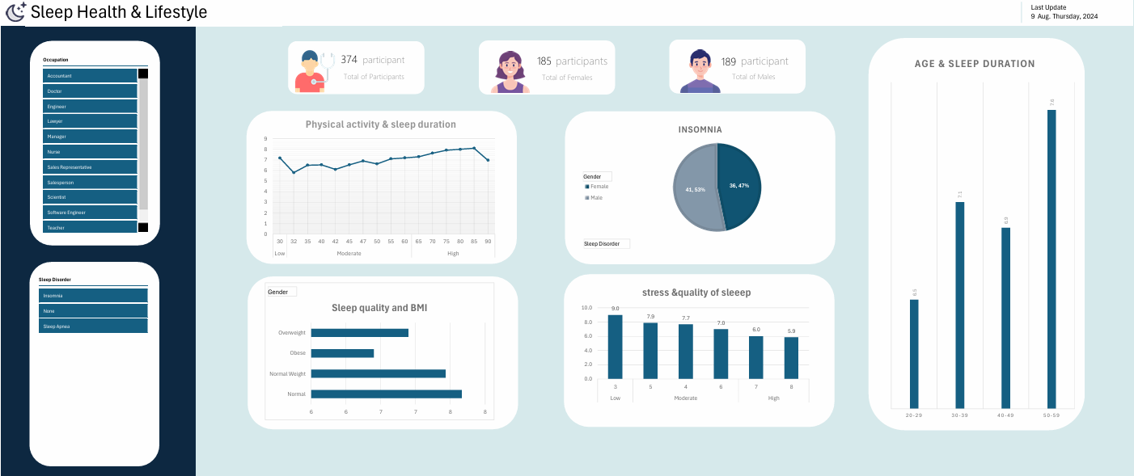
Dashboard Overview
The dashboard provides a visual overview of key metrics, highlighting trends in sleep quality, stress levels, physical activity, and BMI, allowing for easy identification of patterns and insights.

Slide 9
Conclusion
In conclusion, the analysis reveals clear links between lifestyle factors and sleep quality. High stress, low physical activity, and a higher BMI are all associated with poorer sleep, highlighting the need for balanced health habits to improve sleep and overall well-being.

Slide 10

Thanks

